Slide 1
OPTIMUS AIR
SUBMITTED BY-
Shubham Shankar
AXIS8JFSB813

Slide 2
PROJECT OVERVIEW
Optimus Air is a Flight Ticketing application which will help the end-user to search his flights and book it’s ticket.The ticket generated will be in the pdf form and will be send to the end-user E-mail Id.
Further this application will update the check In status of the passengers into it’s Database.After the updation of the check In status,this application will confirm the boarding status of the passenger.

Slide 3
Technologies And Tools Used:
Technologies | Tools
(Back-End) Java8, Spring Boot Microservices, MY-SQL Database (Front-End) HTML CSS JS/ React JS/Bootstrap. | STS, Postman, MY-SQL Database.
Database Requirements: Tables: User:_id,First Name,Middle Name,Last Name,Email and Password. Passenger:id,First Name,Middle Name,Last Name,Email and Phone. Flights:id,Flight no,Operating Airlines,Departure City,Arrival City,Date of departure,Estimated departure time. Reservation:id,Checked In,Number Of Bags,Passenger id,Flight id.

Slide 4
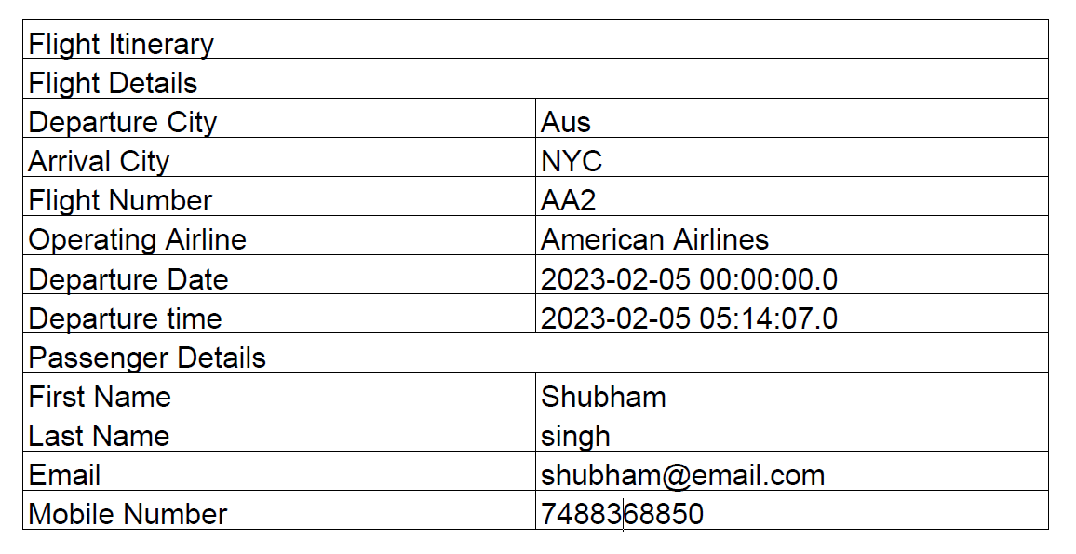
RESULTS
TICKET

Slide 5


